Slide 1
Single Source Shortest Path

Slide 2
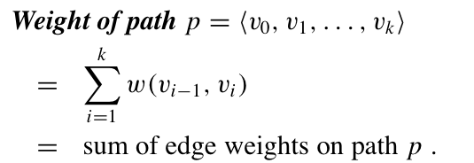
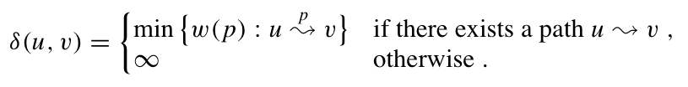
Shortest Path
Directed graph G = (V, E) with weight function
w : E --> R
Shortest path weight:

Slide 3
Shortest Path Applications
for weighted, directed graph G=(V,E)
Weight ~ Cost ~ Distance
Road maps
Airline routes
Telecommunications network routing
VLSI design routing

Slide 4
Various Problems
Single-source shortest-paths problem
Given source node s to all nodes from V
Single-destination shortest-paths problem
From all nodes in V to a destination u
Single-pair shortest-path problem
Shortest path between u and v
All-pairs shortest-paths problem
Shortest paths between all pairs of nodes

Slide 5
Negative-weight Edges
Some edges may have negative weights
If there is a negative cycle reachable from s:
Shortest path is no longer well-defined
Otherwise, it is fine

Slide 6
Cycles
Shortest path cannot have cycles inside
Negative cycles : already eliminated
Positive cycles: can be removed
0-weight cycles: can be removed
So each shortest path does not have cycles

Slide 7
Optimal Substructure Property
Given a shortest path, any subpath is also a shortest path between corresponding nodes
Proof by contradiction

Slide 8
Shortest-paths Tree
For every node v ∈ V, π[v] is the predecessor of v in shortest path from source s to v
Nil if does not exist
All our algorithm will output a shortest-path tree
Root is source s
Edges are (π[v] , v)
The shortest path between s and v is the unique tree path from root s to v.

Slide 9
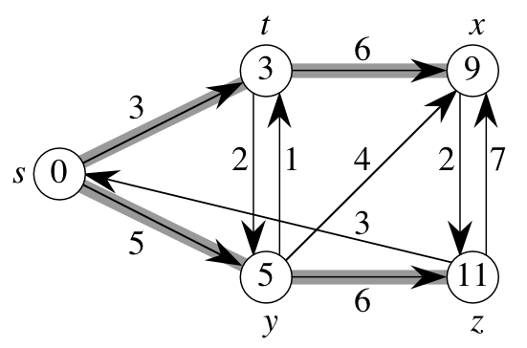
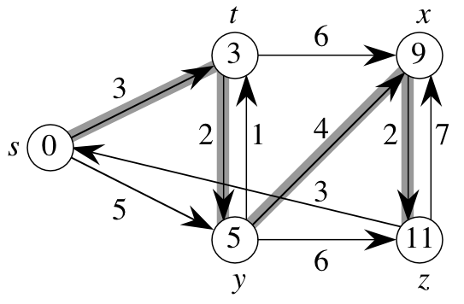
Example

Slide 10
Goal:
Input:
directed weighted graph G = (V, E), source node s ∈ V
Output:
For every vertex v ∈ V,
d[v] = δ (s, v)
π[v]
Shortest-paths tree induced by π[v]

Slide 11
General Results (Relaxation)
Lemma 24.1: Let p = ‹v₁, v₂, …, v_{k}› be a SP from v₁ to v_{k}. Then,
p_{ij} = ‹v_{i}, v_{i+1}, …, v_{j}› is a SP from v_{i} to v_{j}, where 1 ≤ i ≤ j ≤ k.
So, we have the optimal-substructure property.
Bellman-Ford’s algorithm uses dynamic programming.
Dijkstra’s algorithm uses the greedy approach.
Let δ(u, v) = weight of SP from u to v.
Corollary: Let p = SP from s to v, where p = s u →v. Then,
δ(s, v) = δ(s, u) + w(u, v).
Lemma 24.10: Let s ∈ V. For all edges (u,v) ∈ E, we have
δ(s, v) ≤ δ(s, u) + w(u,v).

Slide 12
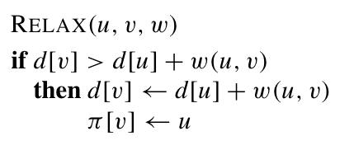
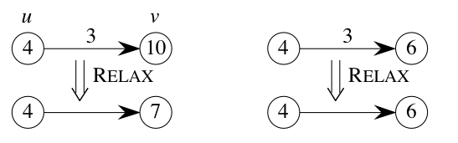
Basic Operation: Relaxation
Maintain shortest-path estimate d[v] for each node
d[v]: initialize ∞
Intuition:
Do we have a
shorter path
if use edge (u,v) ?
Algorithms will repeatedly apply Relax.
Differ in the order of Relax operation

Slide 13
Properties of Relaxation
d[v], if not ∞, is the length of some path from s to v.
d[v] either stays the same or decreases with time
Therefore, if d[v] = δ(s, v) at any time, this holds thereafter
Note that d[v] ≥ δ(s, v) always
After i iterations of relaxing on all (u,v), if the shortest path to v has i edges, then d[v] = δ(s, v).

Slide 14
Properties of Relaxation
Consider any algorithm in which d[v], and π[v] are first initialized by calling
Initialize(G, s) [s is the source], and are only changed by calling Relax. We have:
Lemma 24.11: (∀ v:: d[v] ≥ δ(s, v)) is an invariant.
Implies d[v] doesn’t change once d[v] = δ(s, v).
Corollary 24.12: If there is no path from s to v, then
d[v] = δ(s, v) = ∞ is an invariant.

Slide 15
Shortest-paths Properties
Triangle inequality
For (u, v) ∈ E,
δ (s, v) ≤ δ (s, u) + w(u, v)
Equality holds when u is predecessor of v.
Upper-bound property
If start with d[v] = ∞ and apply Relax operations
Always have d[v] ≥ δ (s, v)
After relaxation for edge (u, v)
d[v] ≥ d[u] + w(u,v) ≥ δ (s,u) + w(u,v) ≥ δ(s,v)
Once d[v] = δ (s, v), never changes

Slide 16



Properties cont.
Convergence property
Suppose s ⇒ u -> v is the shortest path from s to v
Currently d[u] = δ (s, u)
Relax (u,v) will set d[v] = δ (s, v)
Proof: follow from Relaxation definition
Path-relaxation property
Given a shortest path
Apply Relax in order
Then, afterwards,

Slide 17
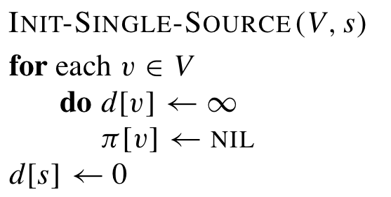
Bellman-Ford Algorithm
Allow negative weights
Follow the frame work that first, initialize:
Then apply a set of Relax
compute d[v] and π[v]
Return False if there exists negative cycles

Slide 18
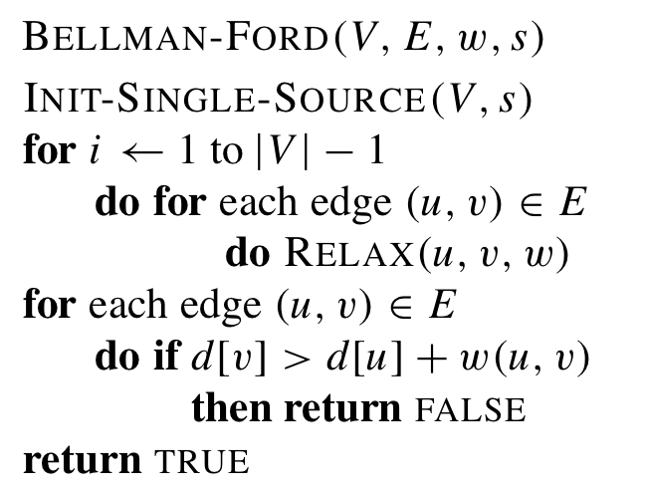
Pseudo-code
Time complexity:
O(VE)

Slide 19
Example
u
v
5
∞
∞
–2
6
–3
8
z
0
7
–4
7
2
∞
∞
9
x
y

Slide 20
Example
u
v
5
6
∞
–2
6
–3
8
z
0
7
–4
7
2
7
∞
9
x
y

Slide 21
Example
u
v
5
6
4
–2
6
–3
8
z
0
7
–4
7
2
7
2
9
x
y

Slide 22
Example
u
v
5
2
4
–2
6
–3
8
z
0
7
–4
7
2
7
2
9
x
y

Slide 23
Example
u
v
5
2
4
–2
6
–3
8
z
0
7
–4
7
2
7
-2
9
x
y

Slide 24
Correctness
Why d[v] = δ (s, v) for every node v ?
Proof: Use path-relaxation property
Return True (or False) iff there is (or is no) negative cycles ?
If there is no negative cycle: obvious
use triangle inequality
If there is negative cycle:
Proof by contradiction

Slide 25
Summary
Given edge (u,v)
δ (s,v) ≤ δ (s,u) + w(u,v)
Relax(u,v,w)
If d[u] = δ (s,u) before the operation
Then d[v] = δ (s,v)
Path relaxation property

Slide 26
Directed Acyclic Graphs
SSSPs in DAGs, allowing negative weights
Can be done in O(|V| + |E|)

Slide 27
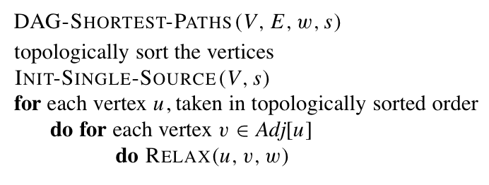
Pseudo-code
Time complexity:
O(|V| + |E|)

Slide 28
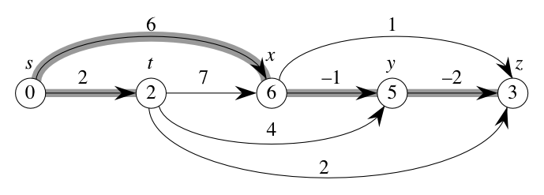
Example

Slide 29
Example
6
1
r
s
t
u
v
w
∞
5
0
2
∞
7
∞
–1
∞
–2
∞
4
3
2

Slide 30
Example
6
1
r
s
t
u
v
w
∞
5
0
2
∞
7
∞
–1
∞
–2
∞
4
3
2

Slide 31
Example
6
1
r
s
t
u
v
w
∞
5
0
2
2
7
6
–1
∞
–2
∞
4
3
2

Slide 32
Example
6
1
r
s
t
u
v
w
∞
5
0
2
2
7
6
–1
6
–2
4
4
3
2

Slide 33
Example
6
1
r
s
t
u
v
w
∞
5
0
2
2
7
6
–1
5
–2
4
4
3
2

Slide 34
Example
6
1
r
s
t
u
v
w
∞
5
0
2
2
7
6
–1
5
–2
3
4
3
2

Slide 35
Example
6
1
r
s
t
u
v
w
∞
5
0
2
2
7
6
–1
5
–2
3
4
3
2

Slide 36
Correctness
Claim: d[v] = δ(s, v) at termination
Assume
is the shortest path
Relax happens in order of path
Therefore claim is true
by Path-Relaxation property
= s
= v

Slide 37
Dijkstra’s Algorithm
Given directed graph G=(V,E), with only non-negative weights
Bear similarity to breadth-first search and Prim’s algorithm
Maintain a set S ∈ V whose shortest-path from source s have already been determined.
Use a min-priority queue Q to store V-S, keys are the shortest path weight estimate d[v]
Repeatedly select next vertex from V-S, and add it to S.

Slide 38
Dijkstra’s Algorithm
Assumes no negative-weight edges.
Maintains a set S of vertices whose SP from s has been determined.
Repeatedly selects u in V–S with minimum SP estimate (greedy choice).
Store V–S in priority queue Q.
Initialize(G, s);
S := ∅;
Q := V[G];
while Q ≠ ∅ do
u := Extract-Min(Q);
S := S ∪ {u};
for each v ∈ Adj[u] do
Relax(u, v, w)
od
od

Slide 39
Example
u
v
∞
1
∞
10
9
2
3
s
0
4
6
5
7
∞
∞
2
x
y

Slide 40
Example
u
v
10
1
∞
10
9
2
3
s
0
4
6
5
7
5
∞
2
x
y

Slide 41
Example
u
v
8
1
14
10
9
2
3
s
0
4
6
5
7
5
7
2
x
y

Slide 42
Example
u
v
8
1
13
10
9
2
3
s
0
4
6
5
7
5
7
2
x
y

Slide 43
Example
u
v
8
1
9
10
9
2
3
s
0
4
6
5
7
5
7
2
x
y

Slide 44
Example
u
v
8
1
9
10
9
2
3
s
0
4
6
5
7
5
7
2
x
y

Slide 45
Dijkstra’s Algorithm
Assume that all edge weights are ≥ 0.
Idea: say we have a set K containing all vertices whose shortest paths from s are known (i.e. d[u] = δ(s,u) for all u in K).
Now look at the “frontier” of K—all vertices adjacent to a vertex in K.
the rest
of the
graph
K
s

Slide 46
Dijkstra’s: Theorem
At each frontier vertex u, update d[u] to be the minimum from all edges from K.
Now pick the frontier vertex u with the smallest value of d[u].
Claim: d[u] = δ(s,u)
min(4+2, 6+1) = 6
4
2
6
1
s
8
6
9
3
min(4+8, 6+3) = 9

Slide 47
Dijkstra’s: Proof
By construction, d[u] is the length of the shortest path to u going through only vertices in K.
Another path to u must leave K and go to v on the frontier.
But the length of this path is at least d[v], (assuming non-negative edge weights), which is ≥ d[u]. 

Slide 48
Proof Explained
shortest path to u
u
d[u] ≤ d[v]
s
K
another path to u, via v
v
Why is the path through v at least d[v] in length?
We know the shortest paths to every vertex in K.
We’ve set d[v] to the shortest distance from s to v via K.
The additional edges from v to u cannot decrease the path length.

Slide 49
Remarks
Similar to breadth-first search,
It adds nodes into S in order of their distance to s
The algorithm also induces a shortest-paths tree

